Slide 1
Computer Architecture CSEN 3104 Lecture 1
Dr. Debranjan Sarkar

Slide 2
What is Computer Architecture ?
Goal
Create a computing system
With best performance
Having least price
Requiring minimum energy consumption
That meets all the functional requirement
Hardware components
Design
Select
Interconnection between different hardware devices
Design Hardware – Software interface

Slide 3
Stored Program Computer (Von Neumann concept)
Early computers were
Mostly not reprogrammable
Executed a single hardwired program
No program instructions -> no program storage
Some computers were programmable
But stored their programs on punched tapes
These were physically fed into the machine as and when needed.
In late 1940s, John von Neumann gave the concept of storing instructions in computer memory
This enabled a computer to perform a variety of tasks in sequence or intermittently

Slide 4
Von Neumann concept
A program may be electronically stored in binary-number format in a memory device
Now instructions may be modified by the computer
A computer with a von Neumann architecture stores program and data in the same memory
Stored-program computer is sometimes used as a synonym for von Neumann architecture, or IAS computer (as it was first developed at the Institute for Advanced Studies)
The von Neumann architecture is also known as Princeton architecture

Slide 5
Von Neumann concept
Stored program concept
Both Data and instructions are stored in a single read-write memory
Arithmetic and Logic Unit (ALU) is capable of operating on binary data
The contents of the memory are addressable by location
The computer executes the program in sequential fashion from one instruction to the next, unless explicitly modified.
A program can modify itself when the computer executes the program

Slide 6
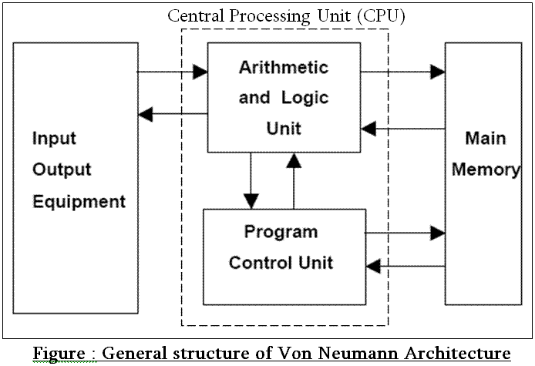
General structure of von Neumann Architecture

Slide 7
What is von Neumann bottleneck?
Von Neumann architecture requires memory access for instruction fetch and for data movement (from and to memory)
Memory access is very slow compared to the speed of the CPU
So CPU has to wait for a long to obtain instruction / data from memory
This greatly degrades the performance of the Von Neumann computer
Also, an instruction fetch and a data operation cannot occur at the same time because they share a common bus. This often limits the performance of the system
The degradation of performance due to CPU-memory speed disparity and due to sharing the same bus for instruction fetch and data read/write is referred to as Von Neumann bottleneck

Slide 8
How von Neumann bottleneck can be overcome?
The performance is improved by using a special type of faster memory (called cache memory) between the CPU and the main memory. The access time of the cache memory is of the order of the speed of the CPU and hence there is almost no waiting time by the CPU for the required data
By using separate instruction cache and data cache
By moving some data into cache before it is requested (pre-fetching) to speed access in the event of a request
By using RISC (Reduced Instruction Set Computer) architecture to limit access to main memory to a few load and store instructions. Other instructions have their operands in CPU registers (not in memory).

Slide 9
Difference between Von Neumann architecture and Harvard architecture
The von Neumann architecture is a stored program concept
It consists of a single memory for both program and data storage
The system performance degrades as program and data cannot be fetched in one cycle
Example: EDVAC (Electronic Discrete Variable Automatic Computer)
whereas
Harvard architecture is also a stored program concept
It has separate program and data memories
Data memory and program memory can be of different width, type etc.
Program and data can be fetched in one cycle – by using separate control signals: ‘program memory read’ and ‘data memory read’
Example: Harvard Mark 1 computer

Slide 10
Thank you

